Slide 1

Software Methodologies & SDLC

Slide 2

Day 1

Slide 3

Learning Outcomes
SDLC, what is it?
7 stages of software development
Focussed look at stages 1-3

Slide 4
Software development Life cycle
What is it? – Process of taking a set of business requirements and, through a series of structured stages, translating these into a working IT system. It may include buying and installing the hardware that the system will run on.
What is the purpose? – Going from a business need to a working computer system in a way that matches requirements within a reasonable timescale and budget

Slide 6

Systems Development
1. Users want a system but don’t know how to build it themselves: - Users’ requirements must be understood
- Users’ requirements must be used to design a system that is as close as possible to those requirements
2. Developers know how to build systems but don’t understand the users’ area of expertise
-The development team needs to gather the information that will help them build a useful system 3. Most systems are too large and complex for one person to create single-handed, so people must work together on them

Slide 7
Systems Development
4. Communication within the development teams becomes important
-Work must be shared between different people
-Work done by different people has to be assembled into a coherent and working system by the end of the project
5. Complex projects in any discipline can easily go wrong
– it’s not just software - You must build the right system as well as building the system right
-When systems development projects go wrong, the cost can be huge

Slide 8
Software Development Life Cycle
1. Feasibility Study
7. Maintenance
2. Requirements Analysis
7 Stages
of
Software Development
6. Deployment
Implementation
3. Design
5. Testing
4. Code Development

Slide 9
Feasibility study

Slide 10
Feasibility study
Feasibility study
What is it? | A high-level (not detailed) examination of a proposed business initiative or project to establish its objectives, scope, costs and benefits for the purpose of deciding whether a more detailed investigation should be undertaken. (Cadle, 2014, p285)
Purpose | The purpose of a feasibility study is to determine whether a problem is worth solving by evaluating possible solutions.
Objectives | To investigate a situation to uncover the issues and then identify and evaluate possible options to resolve those issues
Scope | The business problem that has been identified and a small number (e.g. 3) of possible solutions.
Inputs | Business information – may include operational and financial information.
Outputs | Feasibility report, Business case (which includes cost-benefit analysis)
Interfaces with other stages | Feasibility report goes to requirements analysis stage

Slide 11

Analysis of options
Risk assessment
How is software development initiated when a need or an opportunity is identified?
-A business analysis is conducted.
In the context of the business’s strategy and objectives, it may look at:
1.Current situation
2.Perspectives of different stakeholders:
e.g. owners, managers, staff, customers
3.Analysis of needs
4.Evaluate options
A limited number of options identified and evaluated in the study
-Usually no more than 3 options evaluated
Describe the main activities of a feasibility study
Collection of information
Interview stakeholders, e.g. business owner, directors, managers, users, customers
1. Gather objective data to identify issues, e.g. system performance data, sales data, 2. Customer complaints
3. Consider business processes required
Assessment of risks and implications
Need to assess project risks & business risks
Look at: Risk Probability of occurrence Impact Avoidance actions Scale of impact Mitigation actions
Owner of risk

Slide 12

Feasibility Study Report
Deliverables
Business case, including cost-benefit analysis
Feasibility study report- summarizing the issues and making recommendations
This should be consulted regularly throughout the project to make sure that the project is still on track
This may need to be reviewed and rewritten if there is any change to the circumstances of the business

Slide 13

SDLC
Business requirements
information about the current system
1. Feasibility Study
Feasibility study
cost-benefit analysis
business case
Should we build the system?
7. Maintenance
2. Requirements Analysis
Should we build the system?
Will it deliver more benefits than costs?
High-level examination of solutions to a business problem
6. Deployment
Implementation
3. Design
5. Testing
4. Code Development

Slide 14

Requirements analysis

Slide 15
Requirement analysis
Requirements analysis
What is it? | The process of discovering and documenting the requirements of a system
Purpose | The purpose of requirements analysis is to discover and document the requirements of a system in an organised way with a sufficient level of detail to allow system design to proceed
Objectives | To elicit requirements, analyse them to ensure the right level of quality and detail and review them and sign them off. Configuration management, change control and traceability should also be initiated during requirements analysis
Scope | The solution selected from the feasibility study
Inputs | Feasibility study, information from customers and users
Outputs | Requirements catalogue, glossary of terms, functional models, data models
Interfaces with other stages | Feasibility report from feasibility study & requirements catalogue, glossary of terms, functional models, data models to design phase; requirements catalogue will be used in testing stage to devise user acceptance tests
The most important part of software development Typically consumes about 33% of software development effort
Sources: Cade (2014, Chapter 5), Bell (2005, Chapter 4)

Slide 16
Requirement analysis
Requirements management
Requirements analysis stage in SDLC
Requirements elicitation
Requirements analysis activity
Requirements validation
Finding out what the requirements are
Talking to users and other stakeholders about what the system should do.
Do we have the right information?
Are we building the right system?
Signed off before proceeding
Making sure the requirements meet the standards of ‘good’ requirements
Further elicitation of requirements may be needed
Requirements documentation
Requirements catalogue
Glossary of terms
Functional models
Data models
Configuration management
Change control
Traceability
Source: Cadle (2014, p 61)

Slide 17
Moscow prioritisation
Prior to capturing requirements, the definitions of Must Have, Should Have, Could Have & Won’t Have.
Have need to be agreed with the business. at each level.
MoSCoW (Must Have, Should Have, Could Have, Won't Have this time) is primarily used to prioritise requirements

Slide 18
Requirements Elicitation

Slide 19
Types of Elicitation
User Research
Questionnaires
Interviews
Focus Groups
Documents & Records Analysis

Slide 20

Types of Requirements

Slide 21
Functional vs. non-functional requirements
Non-functional requirements
Non-functional requirements – tend to be properties of the entire system
How the system should perform, including:
Security (non-penetrable, protection)
Availability (operating hours)
Reliability (reliable during operation time)
Performance (response time, throughput, utilisation)
Capacity (transaction volumes)
Continuity (how a system can remain operational)
Supportability (the support team)
Maintainability (how easy is the system to maintain)
Scalability (how the system can grow)
Functional requirements
Functional requirements – tend to be features of parts of the system
What a system is able to do, e.g.
Format invoice
Calculate total
Send to customer
Acknowledge payment

Slide 22
Non-functional requirements
Non-functional requirements and their definitions
Security | Protection of hardware, software and information on the system from theft or damage or unauthorised access
Availability | Probability that a system is operational at a given time
Reliability | Probability that a system will produce correct outputs for a given period
Performance | Amount of work done by a system, e.g. user response times, throughput, efficient use of computing resources
Capacity | Amount of data than can be stored
Continuity | Ability of the system to carry on after a disruption - disaster recovery plans important
Supportability | Ability of technical support personnel to install, configure, and monitor computer products, identify exceptions or faults, debug or isolate faults to root cause analysis, and provide hardware or software maintenance
Maintainability | Simplicity and speed with which a system can be repaired or maintained
Scalability | Capability of a system, network, or process to handle a growing amount of work, or its potential to be enlarged to accommodate that growth.

Slide 23

Requirements Analysis

Slide 24
Requirements analysis activity
Good requirements are:
Categorised – this makes it easier to group them for review
Relevant – must be within scope of the project
Prioritised
Mandatory - must have / should have
Desirable – could have / want (but not now)
Achievable
Understandable and unambiguous – quantified where necessary
Testable
A requirement not a solution
Consistent
Owned – by a senior manager who has the knowledge and authority to make decisions about the requirement
Unique
Traceable – backwards - who initiated it? Forwards - was it implemented?
Concise
Complete
Correct
Conforming with standards
Analysis of requirements
Follows once requirements elicitation is complete
Aim is to make sure that the requirements that have been elicited are ‘good’ and will support the development or procurement of a suitable system
Analysis work inevitably reveals further questions which mean returning to the elicitation stage

Slide 25
Impact of poor requirements
Lead to expensive bugs
About 50% of bugs originate at the requirements analysis stage
Cost of fixing them during the testing phase is 200 times the cost of fixing them at the requirements stage
Poor requirements can . . .
Lead to rejection of a system
If the system doesn’t do what the customer wants, they may reject the system and refuse to pay for at least some of it
Reduce benefits of system
If the system doesn’t meet business or users’ needs, its benefits will be reduced – it may end up being a liability and damaging the customer’s business

Slide 26

Techniques & tools to document requirements

Slide 27

Techniques to document requirements
Use case diagrams
UML
Activity diagrams
Data models
UI models
User stories

Slide 28
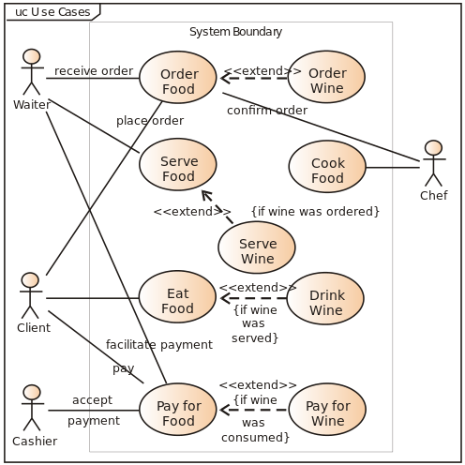
Use case diagrams
representation of a user's interaction with the system that shows the relationship between the user and the different use cases in which the user is involved
a use case is a list of actions or event steps typically defining the interactions between a role (or actor) and a system to achieve a goal. The actor can be a human or other external system.

Slide 29
User stories
They typically follow a simple template:
As a < type of user >, I want < some goal > so that < some reason >.
User stories are short, simple descriptions of a feature told from the perspective of the person who desires the new capability, usually a user or customer of the system.
As a user, I can backup my entire hard drive.
As a student, I want to purchase a parking pass to park my car at school.
User stories are part of the agile methodology. It’s often best to think of them as part as a pointer to the real requirement

Slide 30
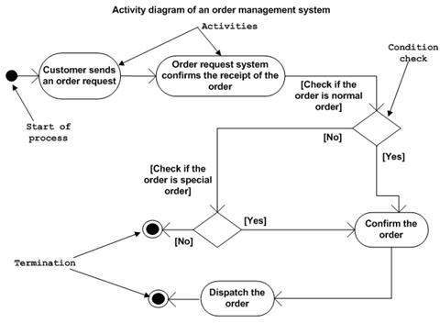
Activity diagrams
Show flow of events through a use case (workflow)
Look a bit like flowcharts, but have extra functionality, e.g. support for concurrency
To draw an activity diagram:
Identify the activities
Work out the associations between them
Identify conditions in which activities happen
Identify constraints
Excludes content of messages passed around
Mainly for business users – won’t match code exactly
actions
start of workflow
decisions
end of workflow

Slide 31
SDLC
Business requirements
information about the current system
1. Feasibility Study
Feasibility study
cost-benefit analysis
business case
Should we build the system?
What should the system do? Who for?
Glossary of terms
requirements catalogue (functional & non-functional)
data dictionary
data models
use cases
functional models
Should we build the system?
Will it deliver more benefits than costs?
High-level examination of solutions to a business problem
2. Requirements Analysis
7. Maintenance
6. Deployment
Implementation
3. Design
5. Testing
4. Code Development

Slide 32

Design

Slide 33
Qualities of a good design
What is good design?
Matches user requirements
As simple as possible
Easy to understand
Easy to use
Easy to make changes
Easy to test
Easy to deploy and monitor for problems
Why does good design lead to better software?
Good match to requirements maximises business benefits
Understandability should make it easier to develop, test and maintain
Ease of use probably leads to more efficient use
Ease of maintenance should extend the life and usefulness of the system
Software design is a process to transform user requirements into a suitable form that details the software solution which assists the programming team in coding and implementation.
The main artefact produced from Software Design is the (SDS) Software Design Specification (also known as the Technical Design Document)

Slide 34

Design considerations

Slide 35
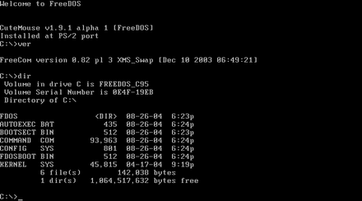

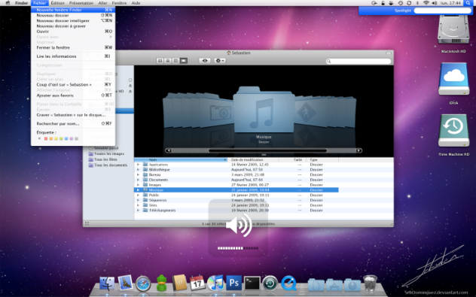
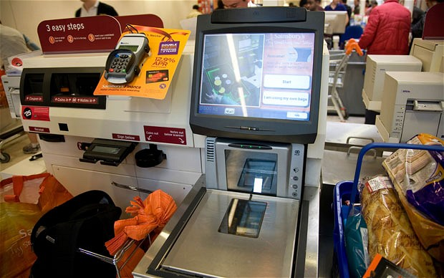
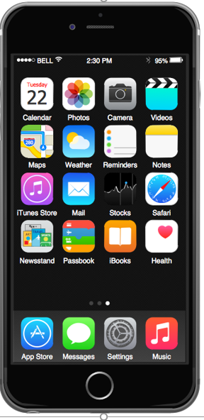
Design user interface
User interface (UI) design is key for the usability of the system. Critical, as it’s all that most users see of the system
User-friendliness can be difficult to measure
Context-dependent
Can be subjective
Prototyping UIs can help
A good UI
Makes users’ tasks as simple and efficient as possible
Helps with data validation
Uses hardware appropriately
Has a consistent look and feel
Is accessible

Slide 36
Design stage activities
Sales order processing
Place
order
Customer
Record delivery
Pick
order
Driver
Raise
invoice
Input and output design Starting point is usually requirements catalogue or functional specification, e.g. use case diagram and use case descriptions. Inputs and outputs identified from where associations between actors and use cases cross system boundary
Picker
Despatch
order
Accounts
Logistics
Use case descriptions used to determine if something is an input or output or a two-way dialogue and the content
Macro level – overall mechanism for achieving input or output
Micro level – detailed user interface design (UI)

Slide 37

Design process
Specifies how functional requirements will be realised in software (programs or package)
High-level
Identifying discrete components of system to meet functional requirements
Detailed program specification
Defines how each component in the high-level design will be built
Both high-level and detailed designs can use similar techniques, such as UML
Main difference is level of detail
Non-functional requirements must be considered, e.g.
Need to produce reusable code
Efficiency, reliability, etc.
Different ways of doing this
Object-oriented
Functional

Slide 38

Software design specification
Technical design document

Slide 39
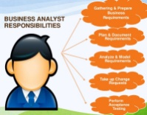
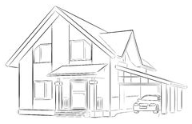
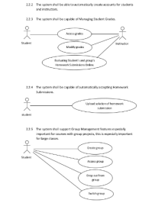


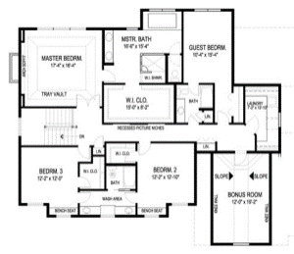
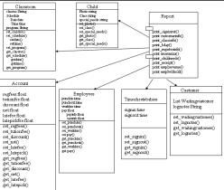



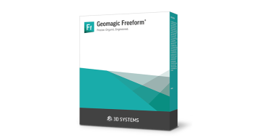
Business Analyst
Software Requirements Specification
Software Design Team
Software design specification
Software Development Team
Software Product

Slide 40
Software design principles
Software design principles represent a set of guidelines to be considered when developing software in order to ensure software is well structured and maintainable
DRY
Don’t Repeat Yourself
Modularisation
Separating the functionality of a program into independent, interchangeable modules, such that each contains everything necessary to execute one aspect of the desired functionality. This is part of the concept separation of concerns
Advantage of modularization:
Smaller components are easier to maintain
Program can be divided based on functional aspects
Desired level of abstraction can be brought in the program
Components with high cohesion can be re-used again
Concurrent execution can be made possible
Desired from security aspect

Slide 41
Functional requirements

Slide 42
Functional requirements
Functional requirements should contain the information necessary to define the actions that must take place within the software, to process inputs and generate outputs. It specifies what the system must do.
A function is described as a set of inputs, the behaviour, and outputs.
Requirements, which are related to functional aspect of software define functions and functionality within and from the software system.
Examples
Search option given to user to search from various invoices.
User should be able to mail any report to management.
Users can be divided into groups and groups can be given separate rights.
Should comply business rules and administrative functions.
Software is developed keeping downward compatibility intact.

Slide 43
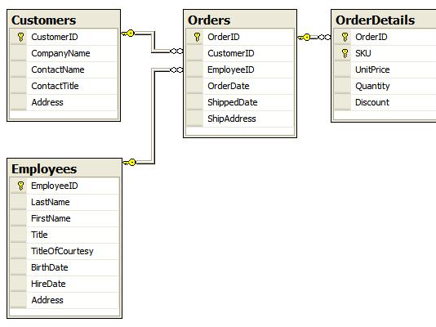
Data design
Objective is to develop a set of flexible data structures that work well with the processes required in the system
Data will usually be put into a relational database
Input is a model of the data requirements, e.g.
UML class diagrams (as shown earlier)
Entity-relationship diagram
similar to UML class diagram, but doesn’t include methods
Output is a normalised entity-relationship diagram
Normalisation is a analysis method that ensures that data is well-structured for inclusion in a database
Removes repeated and redundant information
Ensures that data entities (or database tables) have unique primary keys to support relationships

Slide 44
Component design
System components
The system should consist of a customer-facing front end, which they can get insurance quotes, and a back end for the company to edit the calculations used to generate quotes.
Front end -getting quotes:
A form to input their details
A server-side algorithm to generate the insurance quote from the user's details
A 'view quote' page that the displays the quote to the user once they submit the form
Backend - editing the calculations:
A login form
Server-side functionality to authenticate the use with given login details
Protection of the administration pages from authenticated/authorised users
Dashboard - displaying current calculations matrix for the company
Form to edit calculations for quotes.

Slide 45

Architectural design patterns

Slide 46
Architectural design patterns
An architectural pattern is a general, reusable solution to a commonly occurring problem in software architecture within a given context.
Architectural patterns are similar to software design patterns but have a broader scope.
Some popular patterns are:
MVC Pattern
Client Server Pattern

Slide 47
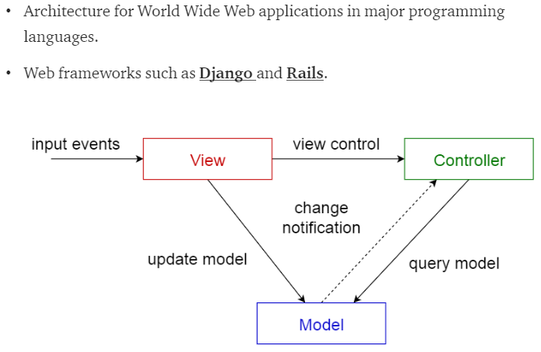
MVC pattern
Model-view-controller pattern
This pattern divides an interactive application in to 3 parts as:
model — contains the core functionality and data
view — displays the information to the user (more than one view may be defined)
controller — handles the input from the user
This is done to separate internal representations of information from the ways information is presented to, and accepted from, the user. It decouples components and allows efficient code reuse.

Slide 48
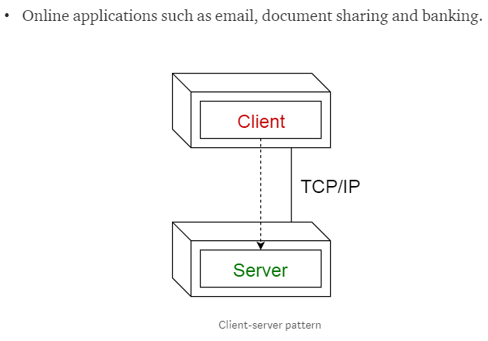
Client side pattern
Client-Server pattern
This pattern consists of two parties; a server and multiple clients.
The server component will provide services to multiple client components.
Clients request services from the server and the server provides relevant services to those clients.
The server continues to listen to client requests.

Slide 49
Non-functional requirements

Slide 50
Non-functional requirements
Non-functional requirements and their definitions
Security | Protection of hardware, software and information on the system from theft or damage or unauthorised access
Availability | Probability that a system is operational at a given time
Reliability | Probability that a system will produce correct outputs for a given period
Performance | Amount of work done by a system, e.g. user response times, throughput, efficient use of computing resources
Capacity | Amount of data than can be stored
Continuity | Ability of the system to carry on after a disruption - disaster recovery plans important
Supportability | Ability of technical support personnel to install, configure, and monitor computer products, identify exceptions or faults, debug or isolate faults to root cause analysis, and provide hardware or software maintenance
Maintainability | Simplicity and speed with which a system can be repaired or maintained
Scalability | Capability of a system, network, or process to handle a growing amount of work, or its potential to be enlarged to accommodate that growth.

Slide 51

A practical world example
Functionally, the car had to be able to transport passengers from some starting location to a particular destination (that is, get passengers from point A to point B).
A variety of non functional attributes or characteristics were also likely considered:
security, safety
maintainability (ease of repair, getting parts)
reliability (probability of failure) buy new or second hand?
scalability (ease of expansion)
efficiency and performance (gas mileage, engine size, capacity
portability (ease of transport -- can it be towed easily or can it tow a trailer)
flexibility (ease of change -- can it adapt to changes in weather/road conditions) usability (ease of use -- comfort, handling, stereo sound quality).
Anyone who has purchased a car, whether they were aware of it or not, made their final decision based on which car met both their functional and non functional needs.

Slide 52
Design stage - summary
Purpose of software design | Translating user requirements into program designs Helping communication Providing a standard and rigorous approach
Rationale for separating functional and non-functional requirements | Functional requirements more likely to be specific to the system Non-functional requirements more general and code re-use may be possible Ensure that non-functional requirements are explicitly stated and not neglected
Software design patterns | Help developers benefit from other developers’ experience and reduce development effort
Documentation of software designs | UML or another diagramming method often used Data model may be designed using entity-relationship modelling
Secure development | Data should be accurate, obey business rules and the law Input validation, physical security and off-site backups all protect data
Software maintainability | Software should be built so that it is easy to maintain Modular design, coding standards and version control all help with this

Slide 53
Design summary
Design stage
What is it? | The stage where design specifications are created for programs and the database and hardware based on requirements
Purpose | Create designs based on requirements
Objectives | To achieve the purpose
Scope | Requirements, including non-functional and hardware
Inputs | Requirements catalogue, glossary, data models …
Outputs | I/O design, UML (process, h/w), data design, UI design, security Technical Design Document (also known as Software Design Specification)
Interfaces with other stages | Designs to coding, testing, deployment, maintenance; requirements from requirements stage; feasibility info from feasibility stage

Slide 54
SDLC
Business requirements
information about the current system
1. Feasibility Study
Feasibility study
cost-benefit analysis
business case
Should we build the system?
Glossary of terms
requirements catalogue (functional & non-functional)
data dictionary
data models
use cases
functional models
What should the system do? Who for?
Should we build the system?
Will it deliver more benefits than costs?
High-level examination of solutions to a business problem
7. Maintenance
2. Requirements Analysis
Translating user requirements into program designs
6. Deployment
Implementation
3. Design
Software Design Document
5. Testing
4. Code Development

Slide 55
Day 2

Slide 56

Learning Outcomes
Visual Studio Code setup
Waterfall and Agile
Focussed look at stage 4

Slide 57
Code development

Slide 58
Code development stage
Code development stage
What is it? | The stage where the technical components (both hardware and software) are created, procured or configured. The developers follow the design to ensure that the system does what is needed for the business or customer.
Purpose | The purpose of the code development stage is to build the system, including writing and unit testing code, installing and setting up packages, buying and installing hardware.
Objectives | Create or purchase the software and hardware needed to meet the requirements and unit test it.
Scope | The system as specified in the design documents
Inputs | Design documents
Outputs | Programs and unit test results, hardware
Interfaces with other stages | Design documents with design stage; programs and unit test results with testing stage

Slide 59
Code development
Code is written according to the designs
Developers' unit test their own code and document the tests and results
Bugs are fixed
Version control software used to store code and manage changes
Coding standards used to promote quality
Programming tools used to facilitate development and increase developers’ efficiency
Peer reviews and retrospectives used to promote quality

Slide 60

Version control

Slide 61
Version Control
Version control (aka source control or revision control)
Using a repository for code that helps manage changes in code
Inevitable changes during development
Exceptionally important to:
Back code up
Manage multiple versions of code (allowing roll-backs to undo mistakes)
Record who made changes and when
Prevent two people from accidentally working simultaneously on the same program
Always be sure what the current version is
Helps programming teams work together effectively, especially where there are barriers to communication, e.g.
Large teams
Geographical separation

Slide 62
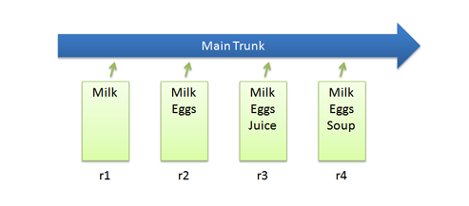
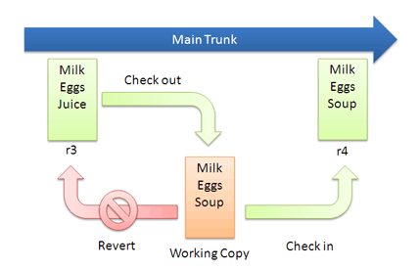
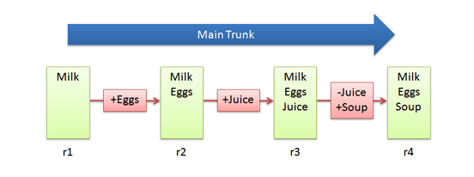
Version control functions
Saving files in a repository
Checking files out for editing
Local copies of checked out files are called working copies
Checking files in after editing
Aka ‘committing changes’
Reverting to a previous version
Tracking differences between versions of files
System has a complete change history of each file

Slide 63
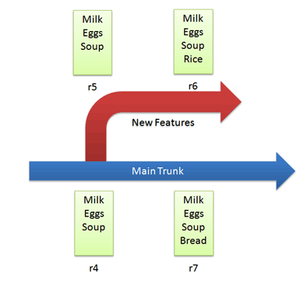
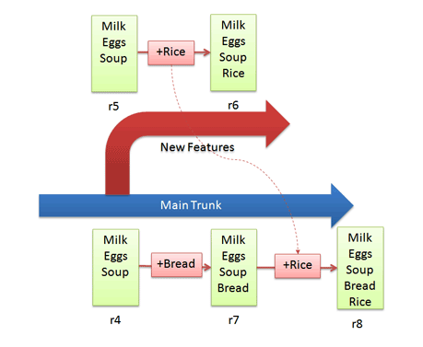
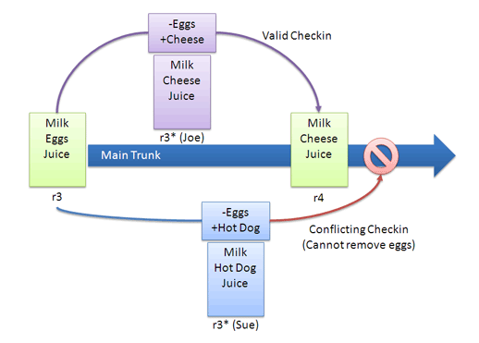
Version control functions
Branching = storing files that diverge from the main path
Called ‘feature branches’ if they will be merged with trunk
Merging = combining changes on a feature branch with the current main version of the file
Resolving conflicts = working out what the correct version of a file contains
Difficult, so may need human intervention

Slide 64

Version control functions
Ways of preventing conflicts:
Locking files that are checked out
Checked out files aren’t locked, but the first person to commit their changes blocks all other changes on the checked-out version of the file

Slide 65
Code development
Unit testing
Individual programs tested in isolation from the rest of the system
Tests and results should be documented
Any bugs found should be fixed
Version control will be important to make sure that changes are properly managed
Automated testing software should be used wherever possible
Quicker and more reliable (and less boring!) than manual testing
Especially useful for regression testing
= repeating previous tests after a bug fix or change to make sure nothing additional has been broken

Slide 66

Configuration & release management

Slide 67

Configuration management
Configuration Management (CM) is a process that tracks all the individual Configuration Items (CI) in an IT system which may be as simple as a single server, or as complex as the entire IT department.
A configuration item (CI) is an IT asset that may depend on or have relationships with other IT processes
Has attributes (technical details and ownership)
Has relationships (to users)
These are assigned by the configuration manager and recorded in the CM database.
The CM database is used for 5 main activities:
Planning
Identification
Monitoring
Control
Verification

Slide 68
Release management
Release management is the process of managing, planning, scheduling and controlling a software build through different stages and environments; including testing and deploying software releases
As software systems become more distributed, they invariably become more specialized and complex
Particularly important for Agile methodologies, as they have frequent software releases

Slide 69
Version control
Version control can be used with configuration management and release management to help manage software that is being developed on multiple platforms
Version control allows release branches to be created for each platform
These are permanent branches that contain code specific to each platform and will be maintained as branches and never merged back into the trunk
Trunk code continues to develop core features, which may be ported to the branch when needed
The branch is frozen prior to a release for a particular platform
for multiple platforms

Slide 70
Coding standards

Slide 71
Coding standards
What are coding standards?
Ways of achieving ‘best practices’ in coding
Aim to improve quality of code and make testing and maintenance easier
Usually specific to an organisation
May include:
User interface style guides – consistent use of logos, fonts, colours, terminology for UI
Reporting standards - consistent use of logos, fonts, colours, terminology for reports
Code module design guidelines – may include
Design requirements for coupling, cohesion and complexity
Comments

Slide 72
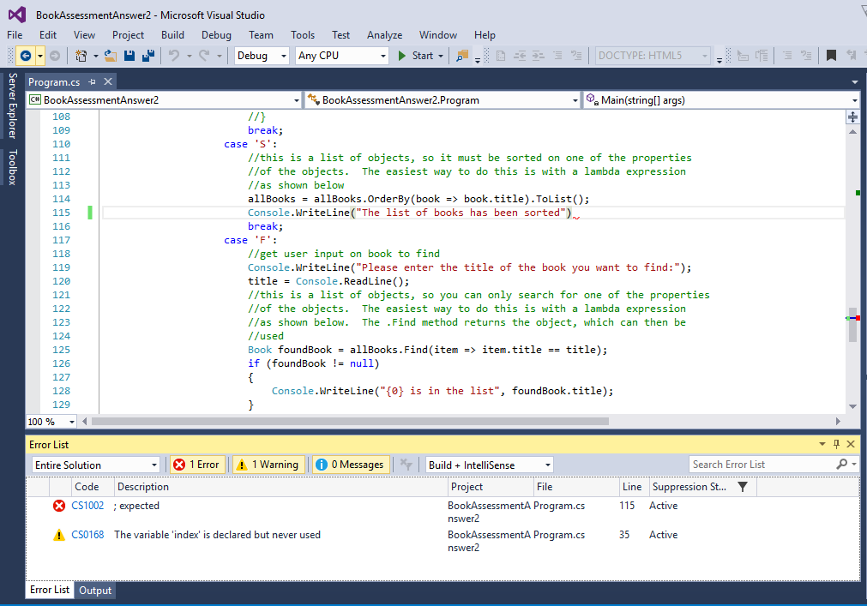
Programming tools
Compilers
Programs that translate source code from a high-level programming language to a lower-level language (e.g., machine code) to create an executable program
Check syntax of source code
Link source code to standard code libraries
Process the entire program on request
Compiled languages include Java, C#, C, C++, Pascal, COBOL, Fortran, Ada
Interpreters
Programs that directly execute instructions written in a programming or scripting language, without previously compiling them into a machine language program
Interpreted languages include JavaScript, BASIC, Perl, Python, MATLAB, Ruby

Slide 73
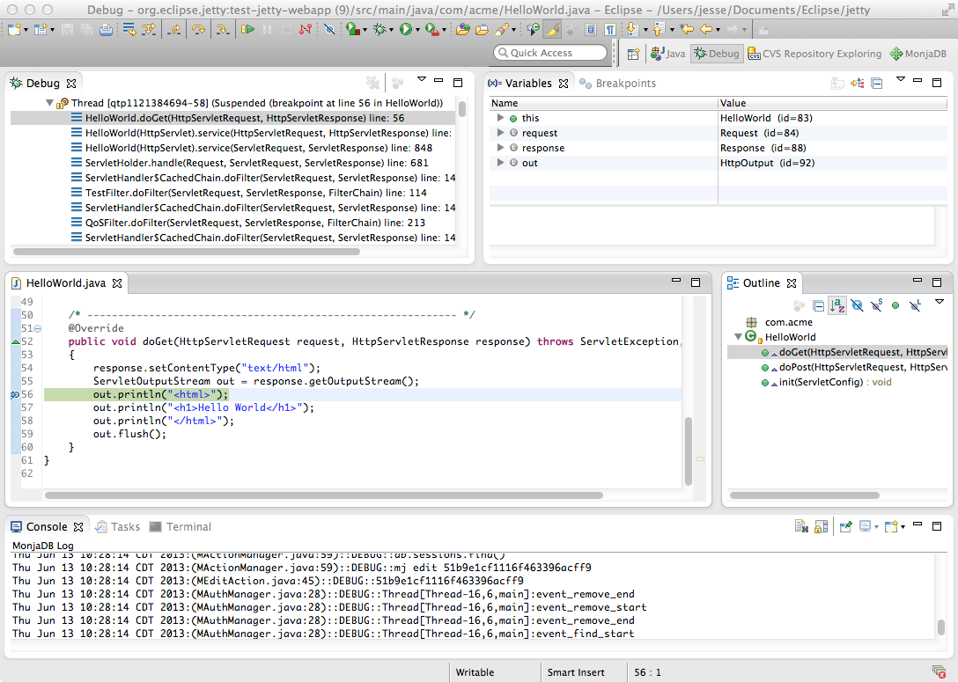
Programming tools
Debuggers
Programs that help to test and find and solve errors in other programs
Often part of an IDE (Integrated Development Environment)
Functions include:
Breaking – developer sets breakpoints - locations in code where execution will stop
Single-stepping – going through code one line at a time
Tracking values of variables
Some debuggers offer:
Performance analysis
Modification of programs while running
Skipping problematic sections of code
Reverse debugging – stepping a program’s execution backwards in time

Slide 74
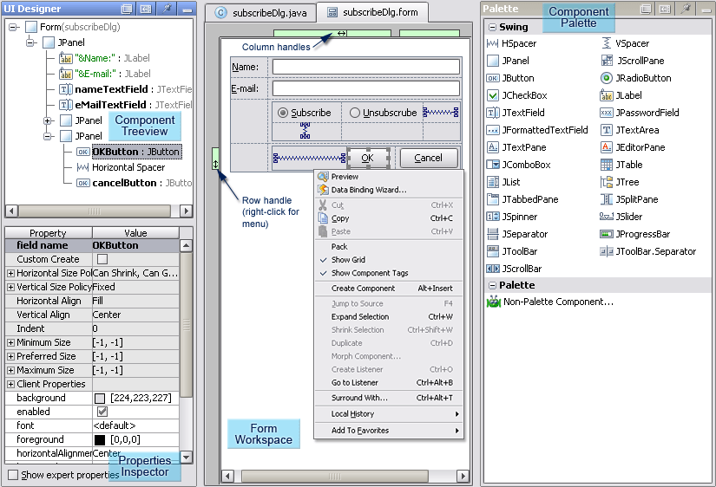
Programming tools
GUI designers
Software development tools that simplify the creation of GUIs by allowing the designer to arrange graphical control elements (often called widgets) using a drag-and-drop WYSIWYG editor
Some produce usable code
Save effort compared to specifying layout in code without visual feedback
Can be used for prototyping
Often included in IDEs, such as IntelliJ, Eclipse and NetBeans

Slide 75
Peer reviews
Peer reviews
A type of software review in which a work product (document, code, or other) is examined by its author and one or more colleagues, in order to evaluate its technical content and quality
Purpose is to provide "a disciplined engineering practice for detecting and correcting defects in software artefacts, and preventing their leakage into field operations" (source: Capability Maturity Model)
Benefits
Favourable return on investment for software inspections: savings exceeds costs by 4 to 1 (source: National Software Quality Experiment)
Savings are greater, when bugs are fixed earlier in the lifecycle, e.g. requirements or design stages
Can be formal or informal
Formal types of peer review (with IEEE definitions, including metrics) include:
Walkthroughs
Technical peer reviews
Software inspections

Slide 76

Retrospectives
Retrospectives
From Agile approach
Take place at the end of each iteration
Key part of Agile – continuous improvement is an Agile principle
Team reflects together on what went well, what could have gone better and actions for improvement
Purpose is to improve the effectiveness of the development team in the future
Honesty and trust is important – the purpose is learning and improvement, not criticism
Benefits
Allow teams to make small improvements regularly in a controlled and immediate manner
Empowers the team and reduces resistance to change
Agile tends to produce higher quality software at lower risk of failure than other approaches

Slide 77
SDLC
Business requirements
information about the current system
1. Feasibility Study
Feasibility study
cost-benefit analysis
business case
Should we build the system?
Glossary of terms
requirements catalogue (functional & non-functional)
data dictionary
data models
use cases
functional models
What should the system do? Who for?
Should we build the system?
Will it deliver more benefits than costs?
High-level examination of solutions to a business problem
7. Maintenance
2. Requirements Analysis
Translating user requirements into program designs
6. Deployment
Implementation
3. Design
Software Design Document
Creating the system/application
5. Testing
4. Code Development

Slide 78
There are many different software methodologies
Methodologies define repeatable processes
Different approaches to implementing SDLC – all of these implement the 7 stages (or a significant subset of them)
Sequential / Linear /Incremental
Waterfall
V model
Spiral
Iterative/evolutionary
Agile methods, e.g. XP, Scrum, Kanban
TDD
Unified Process (UP)
Lean
Dev Ops

Slide 79
Most software development methodologies can be placed into 3 main categories
Agile – Currently widely used model where, requirements and solutions evolve through the collaborative effort of self-organizing and cross-functional teams and their customer/end user.
RAD – Short for Rapid-application development where the development process is based on prototyping without any specific planning.
Waterfall – A traditional sequential model.

Slide 80

Waterfall model
Incremental

Slide 81

Waterfall method
Feasibility
Study
Software development split up into a sequence of well-defined steps
Requirements Analysis
Each stage is finished before the next begins
Design
SDLC steps carried out in sequence
Development
testing
If there have been problems, previous stages can be revisited
Implementation
Each step produces a deliverable that is the input to the next step
Maintenance

Slide 82
Main principles of Waterfall
Structured
Sequential (non-iterative)
Progress is seen as flowing steadily downwards (like a waterfall) through the SDLC stages
Move to the next stage only when its preceding phase is reviewed and verified
If errors are discovered, it is possible to return to earlier stages
Clear milestones
Emphasis on documentation

Slide 83

Waterfall method
Advantages
Simple – easy to understand
Divides a complex task into many smaller, more manageable tasks
Each task produces a well-defined deliverable
Can work well when requirements are clear at the start of a project and don’t change much
Well-established – many IT staff have experience of it
Good fit to highly regulated environments, where standards and documentation are vital
Disadvantages
Client only gets to see the product at the end
No opportunity to validate user requirements with early versions of software
A big problem if the finished system is not what the users wanted
Heavyweight technique – lots of documentation that can easily get out-of-date and is seldom read
Poor estimates of time and resources can lead to later stages getting squeezed and done badly
Higher failure rate of projects
Advantages & disadvantages

Slide 84

Agile
An iterative/evolutionary methodology

Slide 85
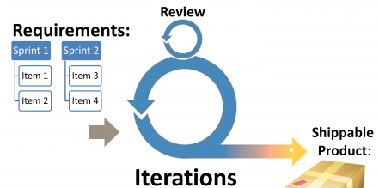
Main principles of agile
Explain the main principles of an agile approach to software development
Adapts to change
Iterative
High user involvement
Focus on product, not project
Code is more important than documentation

Slide 86

Agile
Resources and time are fixed
Features to be delivered are estimated
Contrast to Waterfall, where requirements are seen as fixed, but resources and time are estimated
Project manager controls the project
Delegates responsibility for delivery and authority to use the necessary resources to the development team
Motivates the team, instead of directing them
Progress is monitored through delivery of features and working products
Time spent tracked to improve future estimates
Burn-down charts can be useful for showing what has been done and what is still to be done
Business representatives should be part of the development team and co-operate closely with them
Key features

Slide 87

Agile principles
Our highest priority is to satisfy the customer through early and continuous delivery of valuable software.
Welcome changing requirements, even late in development. Agile processes harness change for the customer's competitive advantage.
Deliver working software frequently, from a couple of weeks to a couple of months, with a preference to the shorter timescale.
Business people and developers must work together daily throughout the project.
Build projects around motivated individuals. Give them the environment and support they need, and trust them to get the job done.
The most efficient and effective method of conveying information to and within a development team is face-to-face conversation.
Working software is the primary measure of progress.
Agile processes promote sustainable development. The sponsors, developers, and users should be able to maintain a constant pace indefinitely.
Continuous attention to technical excellence and good design enhances agility.
Simplicity--the art of maximizing the amount of work not done--is essential.
The best architectures, requirements, and designs emerge from self-organizing teams.
At regular intervals, the team reflects on how to become more effective, then tunes and adjusts its behaviour accordingly.

Slide 88
Agile – Software development methods
Typically, an Agile project will include:
Early and frequent delivery of software – every 2 weeks to 2 months
Working software is the main measure of progress
Changes to requirements are welcome, even late in development
Business people and developers work together daily throughout the project
Face-to-face conversation is the most effective way of communicating information
Simplicity is essential – don’t do unnecessary work
Team regularly reflects on how to be more efficient
Preferred software development methodology for many companies
Adhere to the Agile Manifesto’s four core values:
Individuals and interactions over process and tools
Working software over comprehensive documentation
Customer collaboration over contract negotiation
Responding to change over following a plan
While there is value in the items on the right, we value the items on the left more

Slide 89
Agile
Advantages
Good for novel projects, where requirements are likely to change
Software validated by users throughout the process, so likely to match requirements well
Lightweight technique – minimises unnecessary work
Disadvantages
Big commitment required from users
Less prescriptive, so experienced developers essential to reduce mistakes
Agile method must be well-understood and rules must be rigorously applied
More difficult to apply to large systems (there are frameworks for this)
Difficult to apply regulatory standards which involve documentation
Not suitable for safety-critical systems
No point in doing Agile if the requirements are clearly defined and unlikely to change
Some Agile methods don’t cover the whole lifecycle, e.g. omit stages before coding
Advantages & disadvantages

Slide 90

Scrum
An Agile framework (not a methodology)

Slide 91

Scrum
Scrum is a framework, not a development methodology
Complements development techniques such as Extreme Programming (XP) and Lean Development

Slide 92



Scrum - method
Scrum team:
Product owner – client representative
Scrum master – coaches team to ensure they stick to plans
Team – a self-organising group of 5-9 developers, testers, etc.
Scrum events:
Sprint planning – product owner and team agree on the next sprint
Daily scrum – daily 15-minute meeting for team to share progress and problems
Sprint review – team demos features to stakeholders and gets feedback
Sprint retrospective – team reviews sprint and agrees possible improvement actions
Scrum events:
Sprint planning – product owner and team agree what will be done in that sprint
Daily scrum – daily 15-minute meeting for team to share progress and problems
Sprint review – team demos features to stakeholders and gets feedback
Sprint retrospective – team reviews sprint and agrees possible improvement actions

Slide 93
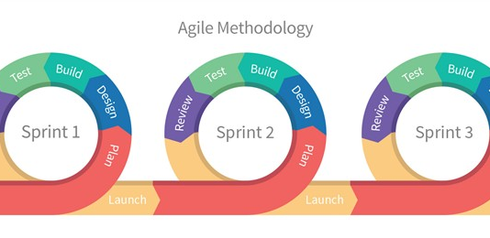
Scrum
Scrum defined as:
A framework within which people can address complex problems, while productively and creatively delivering products of the highest possible value

Slide 94
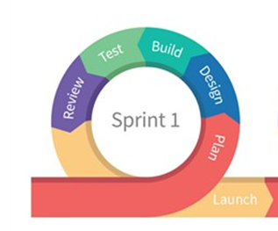
Agile – Scrum – matching to generic stages
Testing
Development
Scrum has most of the generic stages, plus a review stage, but repeats most of them until the most important requirements are completed
Review
Design
Requirements Analysis
Implementation
Feasibility
Study
Maintenance
When the project is finished

Slide 95

Kanban
An Agile framework, not a methodology

Slide 96
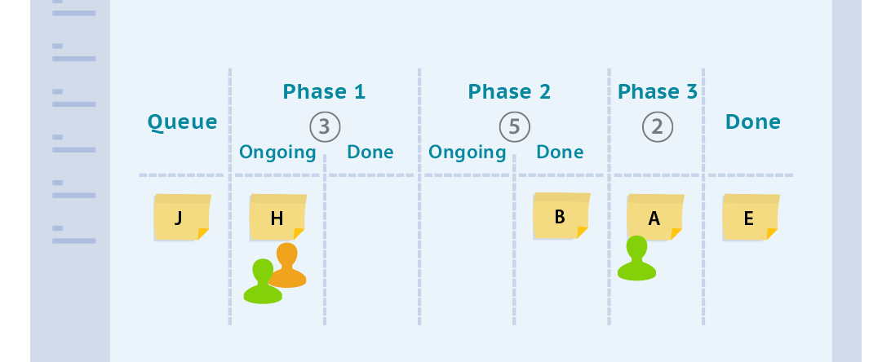
Kanban
Kanban is a popular framework used to implement agile software development. It requires real-time communication of capacity and full transparency of work. Work items are represented visually on a kanban board, allowing team members to see the state of every piece of work at any time.

Slide 97

Kanban
Approach to process change that visualises the flow of work
Aim is to balance demand with available capacity and spot bottlenecks
Work items are visualized to give participants a view of progress and process, from start to finish
Team members pull work as capacity permits
With other methods, work is pushed to team members
Originated in lean manufacturing at Toyota
Focused on the customer and works that meets their needs
Not individuals’ activities
Also used outside of software development, e.g. HR, accounting

Slide 98
Kanban
Six general practices:
Visualisation
Limiting work in progress – work items dealt with singly, not in batches
Flow management
Making policies explicit
Using feedback loops
Collaborative or experimental evolution
These result in:
Seeing the work and its process
Improving the process
Keeping and amplifying useful changes
Learning from, reversing and dampening the ineffective
6 general practices

Slide 99
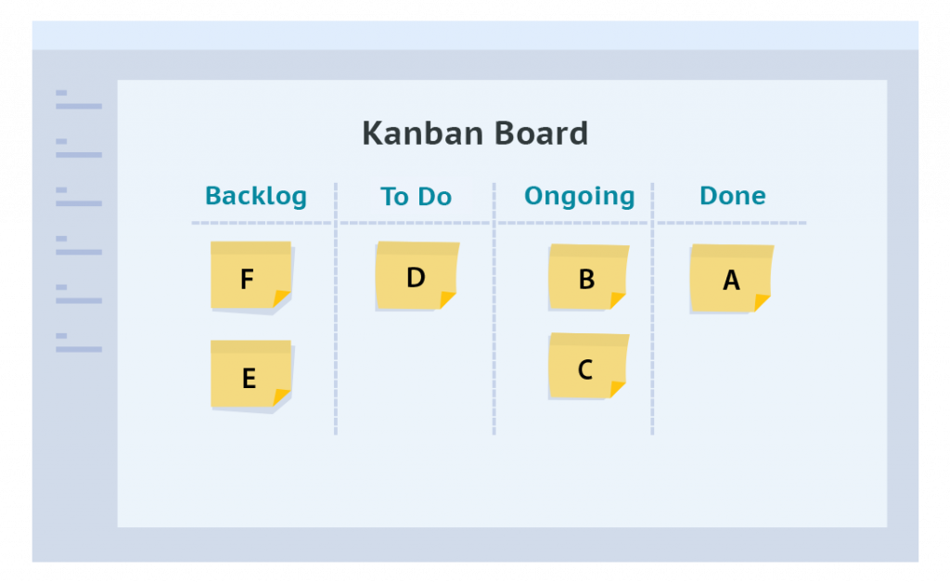
Kanban board
Kanban board
Made up of different swim lanes or columns
Simplest boards have three columns:
To do
In progress
Done
The columns for a software development project may consist of:
Backlog
Ready
Coding
Testing
Approval
Done

Slide 100
Kanban
General approach: stop starting, start finishing
Advantages of Kanban:
Flexible
Reduces wasted work
Easy to understand
Improves delivery flow
Minimises cycle time (amount of time to move through the workflow)
Disadvantages of Kanban
Lack of timeframes
Outdated board can cause problems
Board can get over-complicated
Not specifically a software development methodology
Advantages and disadvantages

Slide 101
Kanban & scrum
Kanban
No prescribed roles
Continuous Delivery
Work is pulled through the system (single piece flow)
Changes can be made at any time
Cycle time
More appropriate in operational environments with a high degree of variability in priority
Scrum
Pre-defined roles of Scrum master, Product owner and team member
Timeboxed sprints
Work is pulled through the system in batches (the sprint backlog)
No changes allowed mid-sprint
Velocity
More appropriate in situations where work can be prioritized in batches that can be left alone
Both Kanban and Scrum focus on releasing software early and often. Both require highly-collaborative and self-managed teams. There are, however, differences between the approaches:

